Slide 1
Chapter-6
Unsupervised Learning

Slide 2
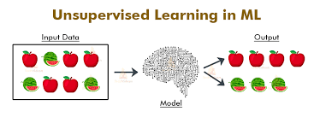
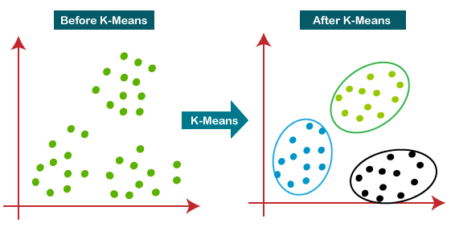
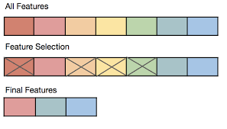
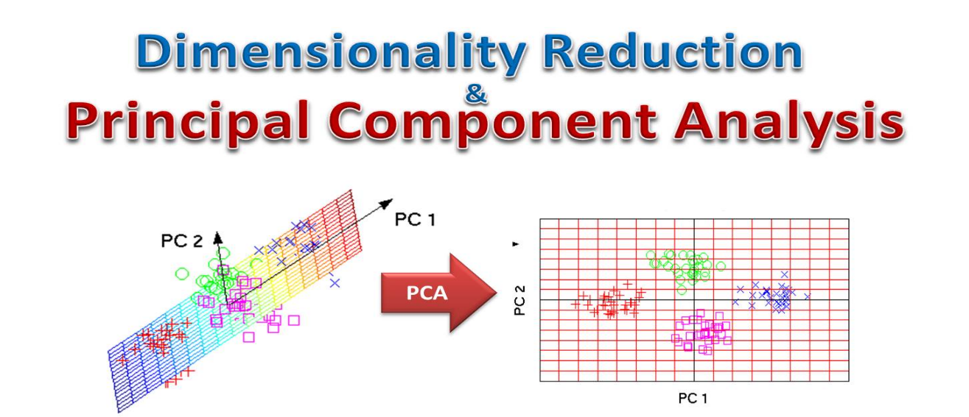

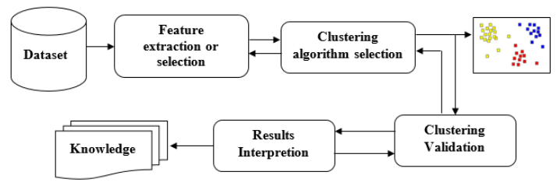

Slide 3
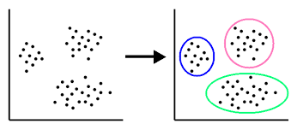
Unsupervised learning
Unsupervised learning aims to find the underlying structure or the distribution of data. We want to explore the data to find some intrinsic structures in them.
Learn from inputs x ₁ , . . . , x _{n} ∈ R^{d} without any labels y₁ , . . . , y_{n}.
*No predefined classes - Clustering

Slide 4
What is Cluster Analysis?
Cluster: a collection of data objects
Similar to one another within the same cluster
Dissimilar to the objects in other clusters
Cluster analysis
Finding similarities between data according to the characteristics found in the data and grouping similar data objects into clusters
Definition. Given a database D ={t₁,t₂,…,t_{n}} of tuples and an integer value k, the clustering problem is to define mapping f:D→{1,…,k} where each t_{i} is assigned to one cluster K_{j}, 1≤ j ≤ k. A cluster, K_{j}, containing precisely those tuples mapped to it; that is, K_{j} = {t_{i} | f(t_{i}) = K_{j}, 1 ≤ i ≤ n, and t_{i} ∈ D}

Slide 5




What is Cluster Analysis?
 Finding groups of objects such that the objects in a group will be similar (or related) to one another and different from (or unrelated to) the objects in other groups
Inter-cluster distances are maximized
Intra-cluster distances are minimized

Slide 6
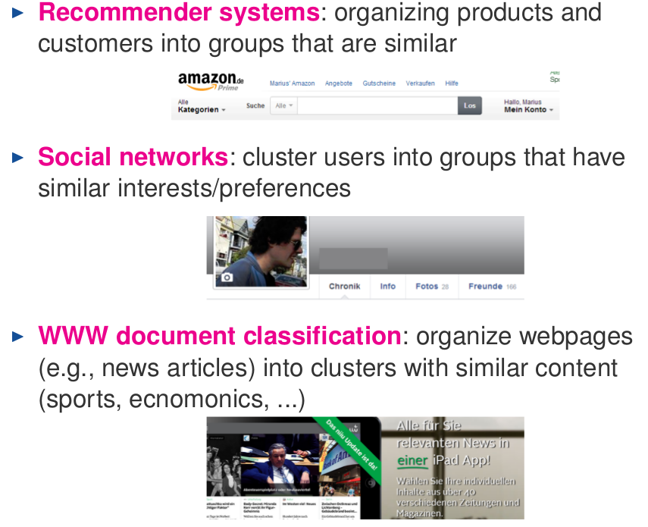
Clustering-Applications
*No predefined classes

Slide 7
What is Good Clustering
A good clustering method will produce high quality clusters with
  high intra-class similarity
  low inter-class similarity
The quality of a clustering result depends on both the similarity measure used by the method and its implementation.

Slide 8
Similarity and Dissimilarity Between Objects
Distances are normally used to measure the similarity or dissimilarity between two data objects
Distance measure greatly depends on the type of the attribute value (binary, nominal, ordinal, etc) that each object will assume.

Slide 9
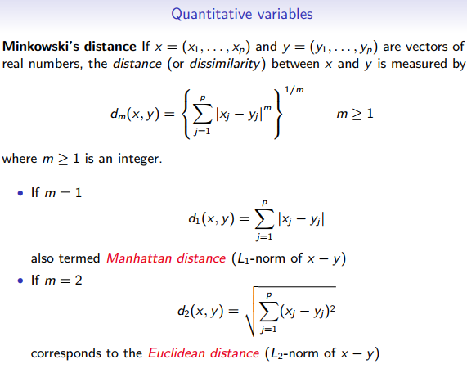

Slide 10
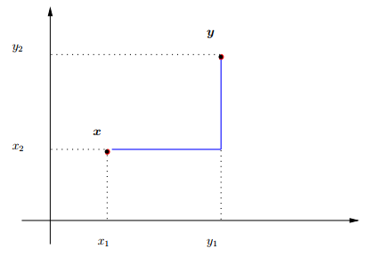
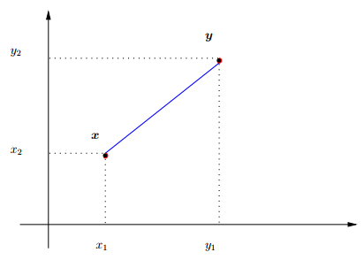
Manhattan distance
Euclidean distance

Slide 11
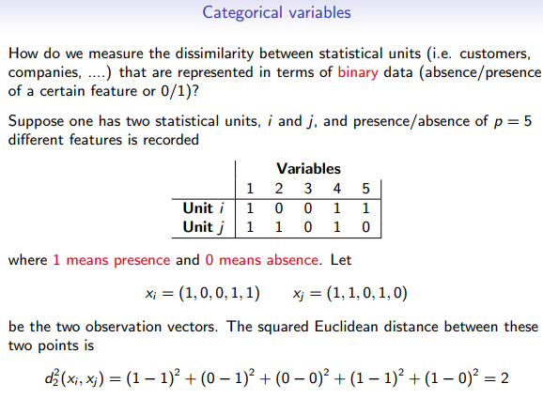

Slide 12
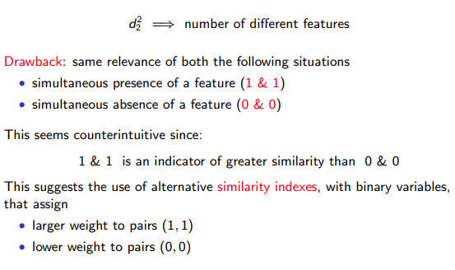

Slide 13
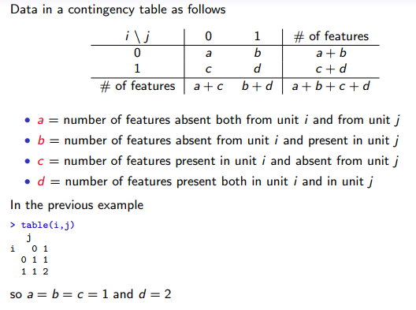

Slide 14
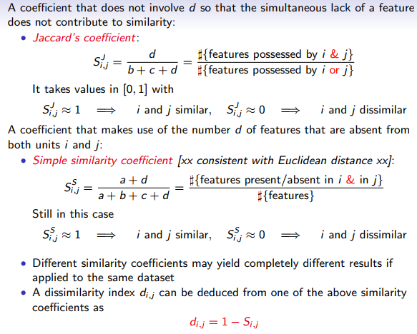

Slide 15
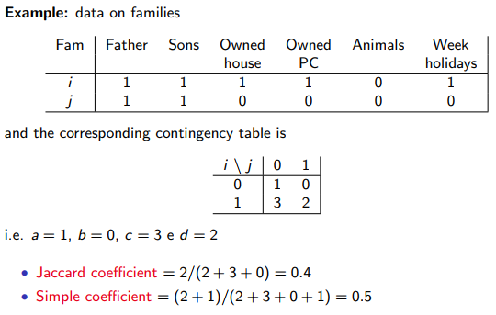

Slide 16
Procedures of Cluster Analysis
A typical cluster analysis consists of four steps

Slide 17
Feature extraction
Procedures of Cluster Analysis
Feature extraction is the process of using one or more transformations of the input features to generate new principal features.
Feature extraction can be elaborated in the context of dimensionality reduction and data visualization.

Slide 18
Clustering algorithm design or selection
Procedures of Cluster Analysis
The clustering step is usually combined with the selection of a corresponding proximity (i.e, the closeness or distance) measure and
the construction of a clustering criterion function (i.e, finding the optimal partitioning of a data set according to some criterion function or agorithm).
Proximity measures refer to the measures of Similarity and Dissimilarity.
Clustering criterion: once a proximity measure is chosen, the construction of a clustering criterion function makes the partition of clusters as an optimization problem.

Slide 19
Cluster validation (Assessment of results)
Procedures of Cluster Analysis
Given a dataset, any clustering algorithm can usually generate clusters, no matter whether the structure exists or not.
Thus, effective evaluation standards and criteria are essential to provide the users with a degree of confidence for the clustering results.
These evaluation methods should be objective and have no preference for any algorithm.

Slide 20
Results Interpretation
Procedures of Cluster Analysis
The final target of clustering is to supply users with meaningful perceptions from the original dataset, with the aim that they can effectively solve the problems faced.
Experts in different domains interpret the data groupings.
Further analyses, even experiments, may be required to assure the reliability of extracted knowledge.

Slide 21
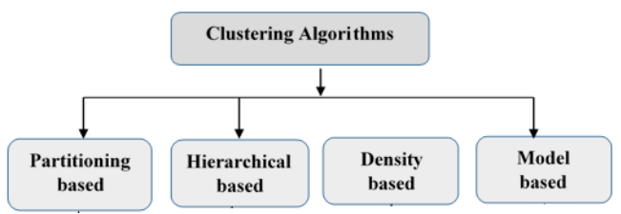
Categories of clustering Algorithms
will not be discussed in this chapter

Slide 22
Partitioning method
Partitioning method: Construct a partition of a database D of n objects into a set of k clusters
Various approaches have been proposed and some of them are:
  K-mean Approach
  K-medoid Approach, CLARA (Custering LARge Application) and CLARANS (CLustering Algorithm based on RANdomized Search) [will not be coverd here]

Slide 23
K-means clustering
K-means is a partitional clustering algorithm
Let the set of data points (or instances) D be
{x₁, x₂, …, x_{n}},
  where x_{i} = (x_{i1}, x_{i2}, …, x_{ir}) is a vector in a real-valued space X ∈R^{r}, and r is the number of attributes (dimensions) in the data.
The k-means algorithm partitions the given data into k clusters.
  Each cluster has a cluster center, called centroid.
  k is specified by the user

Slide 24
K-means algorithm
Given k, the k-means algorithm is implemented in 4 steps:
  Select K centroid (Can be K values randomly, or K data points randomly)
  Partition objects into k subsets. An object will be clustered into class J if it has the smallest distance with this class mean compared to the distance with the other class mean
  Compute the new centroids of the clusters of the current partition. The centroid of the jth cluster is the center (mean point) of the data point whose cluster index is found to be the center of class j in the above step.
  Go back to Step 3, stop when the process converge.

Slide 25
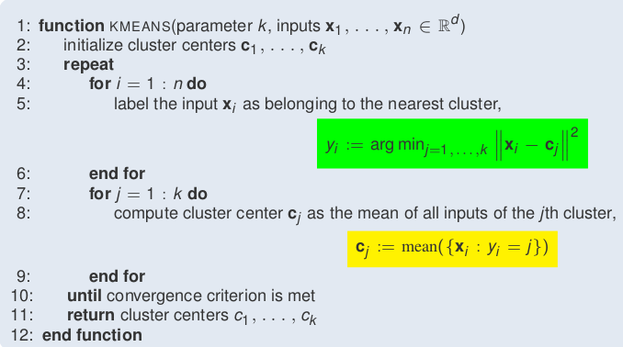
K-means algorithm

Slide 26
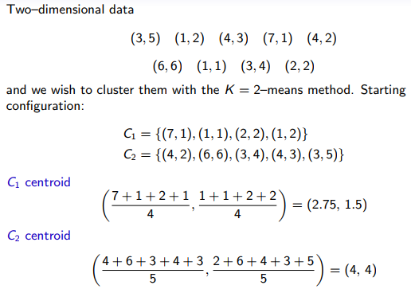
K-Means Clustering – Simple Example

Slide 27
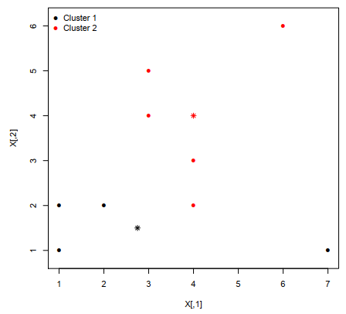
K-Means Clustering – Simple Example

Slide 28
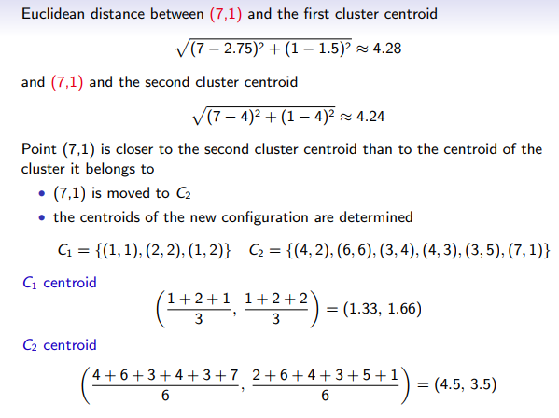
K-Means Clustering – Simple Example

Slide 29
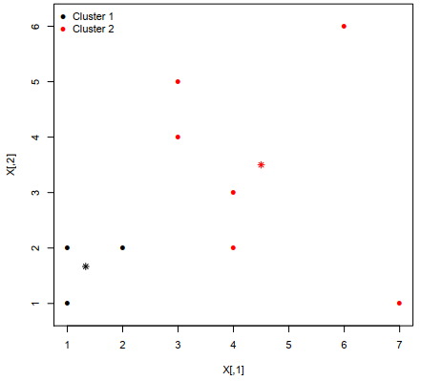
K-Means Clustering – Simple Example

Slide 30
Strengths of k-means
Strengths:
  Simple: easy to understand and to implement
  Efficient: Time complexity: O(tkn), where n is the number of data points, k is the number of clusters, and t is the number of iterations.
  Since both k and t are small. k-means is considered a linear algorithm.
K-means is the most popular clustering algorithm.
Notes:
A local optimum are defined as the relative best solutions within a neighbor solution set. A global optima is a point where the function value is optimum than the value of all other feasible points. There is only one global max/min, but there can be more than one local max/min. Local optima are able to be classified as global optima if the value fof a fuction at all other feasible points is not as optimum as a local optimum point.

Slide 31
Weaknesses of k-means
The algorithm is only applicable if the mean is defined.
  For categorical data, k-mode - the centroid is represented by most frequent values.
The user needs to specify k.
The algorithm is sensitive to outliers
  Outliers are data points that are very far away from other data points.
  Outliers could be errors in the data recording or some special data points with very different values.

Slide 32
K-means summary
Despite weaknesses, k-means is still the most popular algorithm due to its simplicity, efficiency and
  other clustering algorithms have their own lists of weaknesses.
No clear evidence that any other clustering algorithm performs better in general
  although they may be more suitable for some specific types of data or applications.
Comparing different clustering algorithms is a difficult task. No one knows the correct clusters!

Slide 33
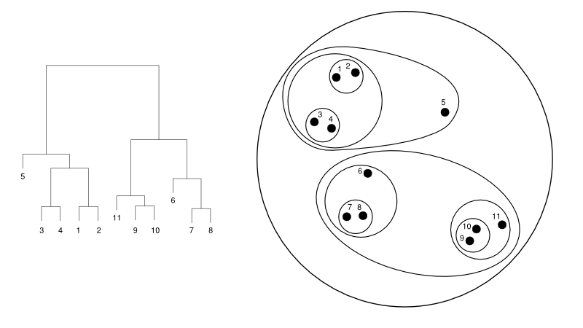
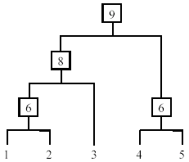
Hierarchical Clustering
Produce a nested sequence of clusters, a tree, also called Dendrogram.

Slide 34
Types of hierarchical clustering
Agglomerative (bottom up) clustering: It builds the dendrogram (tree) from the bottom level, and
  merges the most similar (or nearest) pair of clusters
  stops when all the data points are merged into a single cluster (i.e., the root cluster).
Divisive (top down) clustering: It starts with all data points in one cluster, the root.
  Splits the root into a set of child clusters. Each child cluster is recursively divided further
  stops when only singleton clusters of individual data points remain, i.e., each cluster with only a single point

Slide 35
Types of hierarchical clustering
Step 0
Step 1
Step 2
Step 3
Step 4
Agglomerative Nesting
(AGNES)
a
a b
b
a b c d e
c
c d e
d
d e
e
a
a b
b
a b c d e
c
Divisive Analysis
(DIANA)
c d e
d
d e
e
Step 4
Step 3
Step 2
Step 1
Step 0

Slide 36
Agglomerative clustering
It is more popular than divisive methods.
At the beginning, each data point forms a cluster (also called a node).
Merge nodes/clusters that have the least distance.
Go on merging
Eventually all nodes belong to one cluster

Slide 37
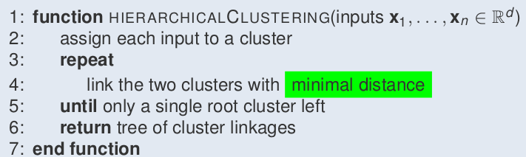
Agglomerative clustering algorithm

Slide 38
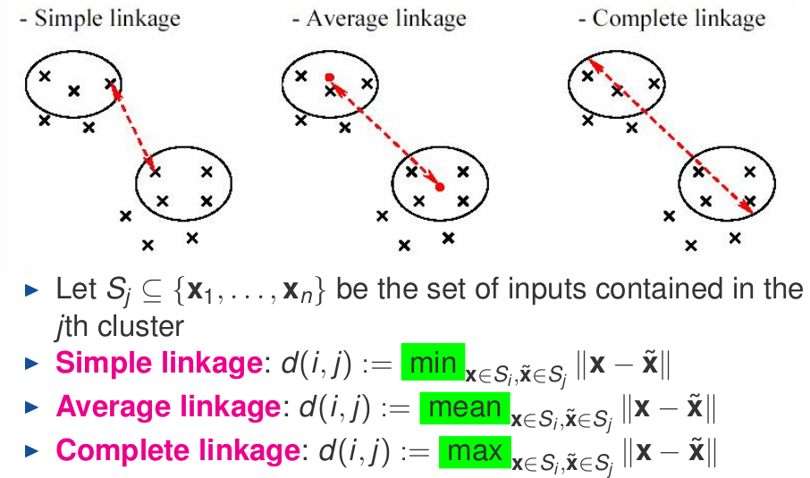
Measuring the distance of two clusters

Slide 39
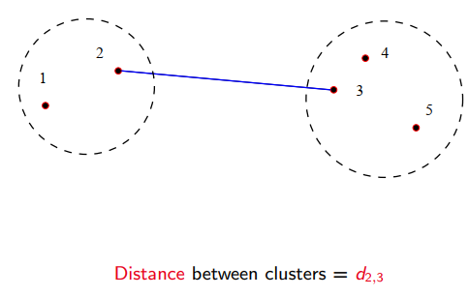
Single link method
The distance between two clusters is the distance between two closest data points in the two clusters, one data point from each cluster.
It can find arbitrarily shaped clusters, but
  It may cause the undesirable “chain effect” by noisy points

Slide 40
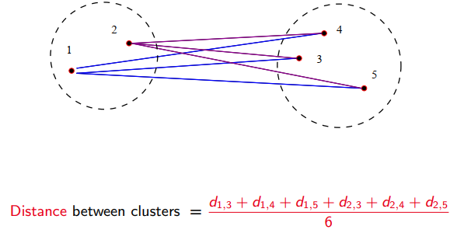
Average link and centroid methods
Average link: the distance between two clusters is the average distance of all pair-wise distances between the data points in two clusters.
Centroid method: In this method, the distance between two clusters is the distance between their centroids

Slide 41
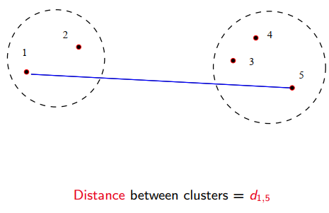
Complete link method
The distance between two clusters is the distance of two furthest data points in the two clusters.
It is sensitive to outliers because they are far away

Slide 42
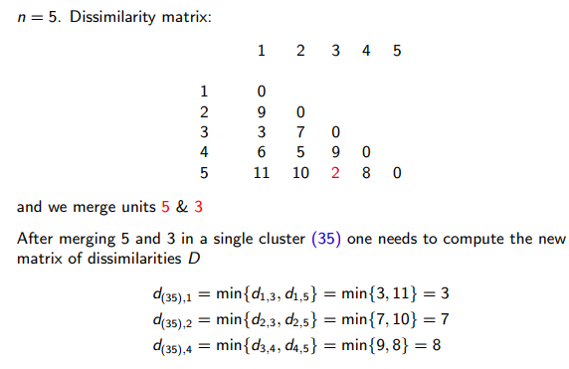
Example with single linkage

Slide 43
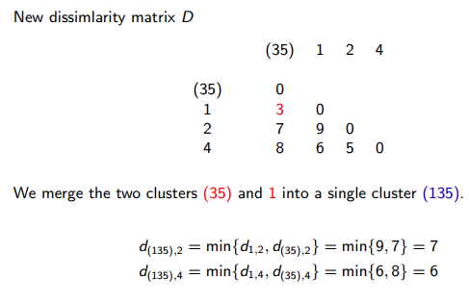
Example with single linkage

Slide 44
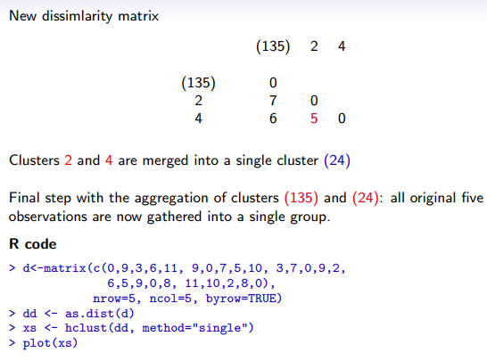
Example with single linkage

Slide 45
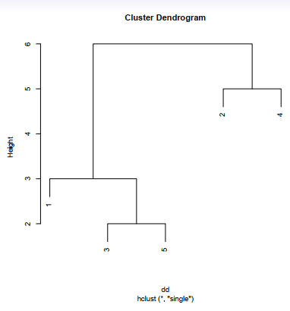
Example with single linkage

Slide 46
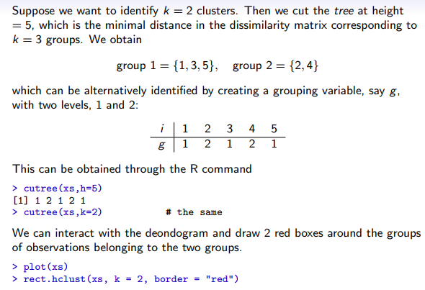
Example with single linkage

Slide 47
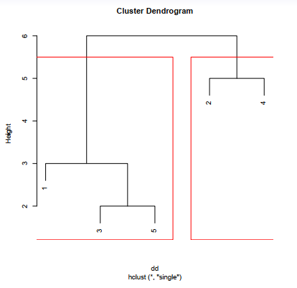
Example with single linkage
Notes:
The decision of the no. of clusters that can best depict different groups can be chosen by observing the dendrogram. The best choice of the no. of clusters is the no. of vertical lines in the dendrogram cut by a horizontal line that can transverse the maximum distance vertically without intersecting a cluster.

Slide 48
Hierarchical Clustering: the complexity
All the algorithms are at least O(n²). n is the number of data points.
Single link can be done in O(n²).
Complete and average links can be done in O(n²logn).
Due the complexity, hard to use for large data sets.

Slide 49
Hierarchical Clustering: Problems and Limitations
 Once a decision is made to combine two clusters, it cannot be undone
 No objective function is directly minimized
 Different schemes have problems with one or more of the following:
  Sensitivity to noise and outliers
  Difficulty handling different sized clusters and convex shapes
  Breaking large clusters

Slide 50
Density-Based Clustering Methods
Clustering based on density (local cluster criterion), such as density-connected points
  Enable us to discover clusters with arbitrary shape
  It has better power of handle noise
These typically regard clusters as dense regions of objects in the data space that are separated by regions of low density (representing noise).
In the figure bellow which of the data points are group to each other locally

Slide 51
Density-Based Clustering Methods
Several interesting studies:
  DBSCAN
  HDSCAN
  OPTICS:
  DENCLUE:
  GRADIENT
  CLIQUE:
Detail is left for reading
Notes:
DBSCAN can only provide a flat (non-hierarchical) clustering of the data objects, based on a global density threshold, while
HDBSCAN is a hierarchical extension of DBSCAN algorithm for varying epsilon threshold values

Slide 52
Model-Based Clustering Methods
Attempt to optimize the fit between the data set available and some mathematical model
Some modeling techniques include
  Expectation maximization (To be discussed here)
  COBWEB
  CLASSIT
  AutoClass
  Neural network approaches (SOM)

Slide 53
Model-Based Clustering Methods
Expectation Maximization
Expectation maximization (EM) is a well-known algorithm used for clustering in the context of mixture models.
This method estimates missing parameters of probabilistic models.
Generally, this is an optimization approach, which had given some initial approximation of the cluster parameters and iteratively performs two steps:
First, the expectation step computes the values expected for the cluster probabilities,
Second, the maximization step computes the distribution parameters and their likelihood given the data.

Slide 54
Model-Based Clustering Methods
Expectation Maximization
It iterates until the parameters being optimized reach a fixed point or until the log-likelihood function, which measures the quality of clustering, reaches its maximum.
The algorithm is similar to the K-means procedure in that a set of parameters are re-computed until a desired convergence value is achieved.
The finite mixtures model assumes all attributes to be independent random variables.
A mixture is a set of N probability distributions where each distribution represents a cluster.
An individual instance is assigned a probability that it would have a certain set of attribute values given it was a member of a specific cluster.

Slide 55
Model-Based Clustering Methods
Expectation Maximization
In the simplest case N=2, the probability distributes are assumed to be normal
Using the scenario, the job of the algorithm is to determine the value of five parameters, specifically:
The mean and standard deviation for cluster 1
The mean and standard deviation for cluster 2
The class probability P for cluster 1 (the probability for cluster 2 is 1-P)

Slide 56

Model-Based Clustering Methods
Expectation Maximization
The general procedure states as follow:
Guess initial values for the five parameters.
Use the probability density function for a normal distribution to compute the cluster probability for each instance.
In the case of a single independent variable with mean μ and standard deviation σ, the formula is:
This gives the probability of a value to
each cluster by changing the mean
and variance
Use the probability scores to re-estimate the five parameters.
Return to Step 2.

Slide 57

Model-Based Clustering Methods
Expectation Maximization
The algorithm terminates when a formula that measures cluster quality no longer shows significant increases.
One measure of cluster quality is the likelihood that the data came from the dataset determined by the clustering.
The likelihood computation is simply the multiplication of the sum of the probabilities for each of the instances
With two clusters A and B containing instances x1, x2, x3,…,xn where p & (1-p) are the class probability of class A & B respectively, the likely hood becomes\

Slide 58





Model-Based Clustering Methods
Expectation Maximization
The third step is the re-estimation of the mean, variance and class probability
This can be done as follows

Slide 59



Model-Based Clustering Methods
Expectation Maximization
Once, the modified mean is computed, we use the mean to compute the modified variance as follows
Moreover, the class probability can be computed as

Slide 60
Data standardization
In the Euclidean space, standardization of attributes is recommended so that all attributes can have equal impact on the computation of distances.
Consider the following pair of data points
  x_{i}: (0.1, 20) and x_{j}: (0.9, 720).
The distance is almost completely dominated by (720-20) = 700.
Standardize attributes: to force the attributes to have a common value range

Slide 61
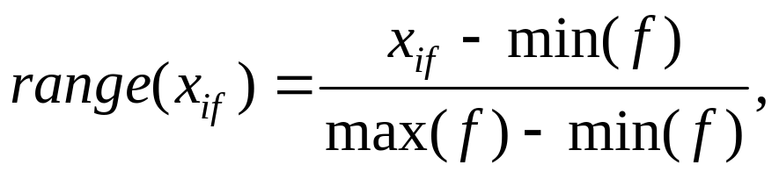
Interval-scaled attributes
Their values are real numbers following a linear scale.
  The difference in Age between 10 and 20 is the same as that between 40 and 50.
  The key idea is that intervals keep the same importance through out the scale
Two main approaches to standardize interval scaled attributes, range and z-score. f is an attribute

Slide 62
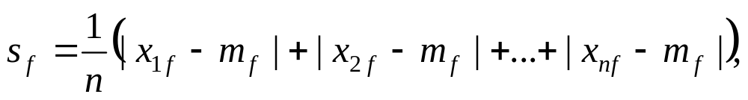
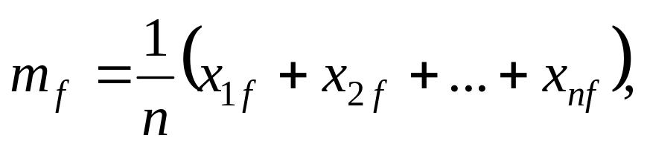
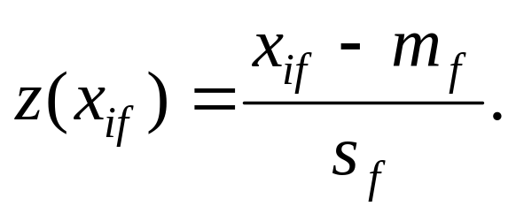
Interval-scaled attributes (cont …)
Z-score: transforms the attribute values so that they have a mean of zero and a mean absolute deviation of 1. The mean absolute deviation of attribute f, denoted by s_{f}, is computed as follows
Z-score:

Slide 63
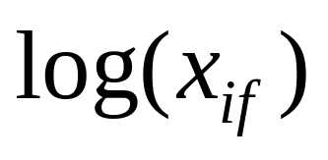
Ratio-scaled attributes
Numeric attributes, but unlike interval-scaled attributes, their scales are exponential,
For example, the total amount of microorganisms that evolve in a time t is approximately given by
Ae^{Bt},
  where A and B are some positive constants.
Do log transform:
  Then treat it as an interval-scaled attribute

Slide 64
Nominal attributes
Sometime, we need to transform nominal attributes to numeric attributes.
Transform nominal attributes to binary attributes.
  The number of values of a nominal attribute is v.
  Create v binary attributes to represent them.
  If a data instance for the nominal attribute takes a particular value, the value of its binary attribute is set to 1, otherwise it is set to 0.
The resulting binary attributes can be used as numeric attributes, with two values, 0 and 1.

Slide 65
Nominal attributes: an example
Nominal attribute fruit: has three values,
  Apple, Orange, and Pear
We create three binary attributes called, Apple, Orange, and Pear in the new data.
If a particular data instance in the original data has Apple as the value for fruit,
  then in the transformed data, we set the value of the attribute Apple to 1, and
  the values of attributes Orange and Pear to 0

Slide 66
Ordinal attributes
Ordinal attribute: an ordinal attribute is like a nominal attribute, but its values have a numerical ordering. E.g.,
  Age attribute with values: Young, MiddleAge and Old. They are ordered.
  Common approach to standardization: treat is as an interval-scaled attribute.

Slide 67
Mixed attributes
Our distance functions given are for data with all numeric attributes, or all nominal attributes, etc.
Practical data has different types:
  Any subset of the 6 types of attributes,
    interval-scaled,
    symmetric binary,
    asymmetric binary,
    ratio-scaled,
    ordinal and
    nominal

Slide 68
Convert to a single type
One common way of dealing with mixed attributes is to
  Decide the dominant attribute type, and
  Convert the other types to this type.
E.g, if most attributes in a data set are interval-scaled,
  we convert ordinal attributes and ratio-scaled attributes to interval-scaled attributes.
  It is also appropriate to treat symmetric binary attributes as interval-scaled attributes.

Slide 69
Convert to a single type (cont …)
It does not make much sense to convert a nominal attribute or an asymmetric binary attribute to an interval-scaled attribute,
  but it is still frequently done in practice by assigning some numbers to them according to some hidden ordering, e.g., prices of the fruits
Alternatively, a nominal attribute can be converted to a set of (symmetric) binary attributes, which are then treated as numeric attributes.

Slide 70
How to choose a clustering algorithm
Clustering research has a long history. A vast collection of algorithms are available.
  We only introduced several main algorithms.
Choosing the “best” algorithm is a challenge.
  Every algorithm has limitations and works well with certain data distributions.
  It is very hard, if not impossible, to know what distribution the application data follow. The data may not fully follow any “ideal” structure or distribution required by the algorithms.
  One also needs to decide how to standardize the data, to choose a suitable distance function and to select other parameter values.

Slide 71
Choose a clustering algorithm (cont …)
Due to these complexities, the common practice is to
  run several algorithms using different distance functions and parameter settings, and
  then carefully analyze and compare the results.
The interpretation of the results must be based on insight into the meaning of the original data together with knowledge of the algorithms used.
Clustering is highly application dependent and to certain extent subjective (personal preferences).

Slide 72
Cluster Evaluation
For cluster analysis, the question is how to evaluate the “goodness” of the resulting clusters?
But “clusters are in the eye of the beholder”!
Then why do we want to evaluate them?
  To avoid finding patterns in noise
  To compare clustering algorithms
  To compare two sets of clusters
  To compare two clusters
  Measuring Cluster Quality:
    Ground truth is the ideal clustering that is often built using human experts.
    Extrinsic Method: If ground truth is available, compares the clustering against the ground truth and measure.
    Intrinsic Method: If ground truth is not available, evaluate goodness of a clustering by considering how well the clusters are separated.

Slide 73
Different Aspects of Cluster Validation
Determining the clustering tendency of a set of data, i.e., distinguishing whether non-random structure actually exists in the data.
Comparing the results of a cluster analysis to externally known results, e.g., to externally given class labels.
Evaluating how well the results of a cluster analysis fit the data without reference to external information.
  - Use only the data
Comparing the results of two different sets of cluster analyses to determine which is better.
Determining the ‘correct’ number of clusters.
For 2, 3, and 4, we can further distinguish whether we want to evaluate the entire clustering or just individual clusters.

Slide 74
Measures of Cluster Validity
Numerical measures that are applied to judge various aspects of cluster validity, are classified into the following three types.
  Internal Index: Used to measure the goodness of a clustering structure without reference to external information.
    E.g., Sum of Squared Error (SSE)
  External Index: Used to measure the extent to which cluster labels match externally supplied class labels.
    E.g., entropy, purity, precision, recall
  Relative Index: Used to compare two different clusterings or clusters.
    Often an external or internal index is used for this function, e.g., SSE or entropy
Sometimes these are referred to as criteria instead of indices
  However, sometimes criterion is the general strategy and index is the numerical measure that implements the criterion.

Slide 75
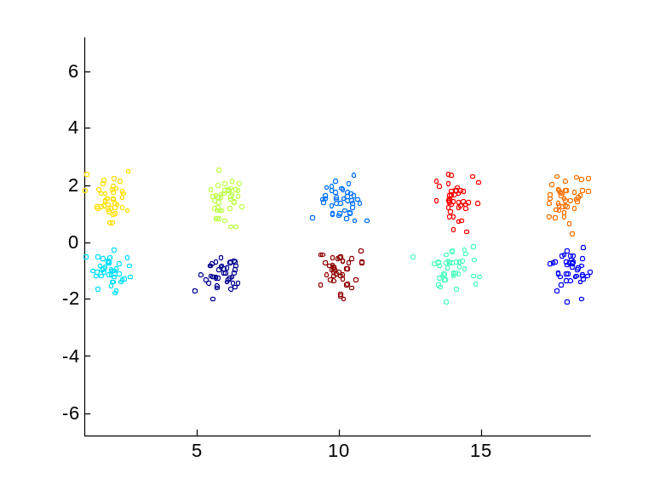
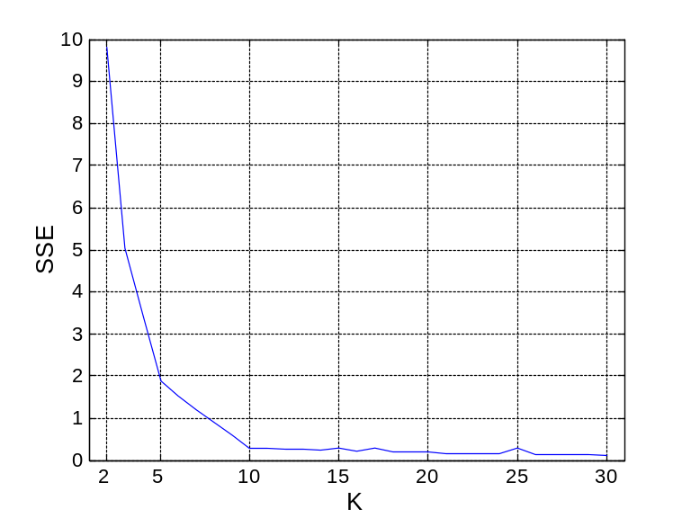
Internal Measures: SSE
Internal Index: Used to measure the goodness of a clustering structure without reference to external information
  Example: SSE
SSE is good for comparing two clusterings or two clusters (average SSE).
Can also be used to estimate the number of clusters

Slide 76
Estimating the “right” number of clusters
Typical approach: find a “knee” in an internal measure curve using a scree plot/elbow method.
Question: why not the k that minimizes the SSE?
  Forward reference: minimize a measure, but with a “simple” clustering
Desirable property: the clustering algorithm does not require the number of clusters to be specified (e.g., DBSCAN)
Scree plot

Slide 77
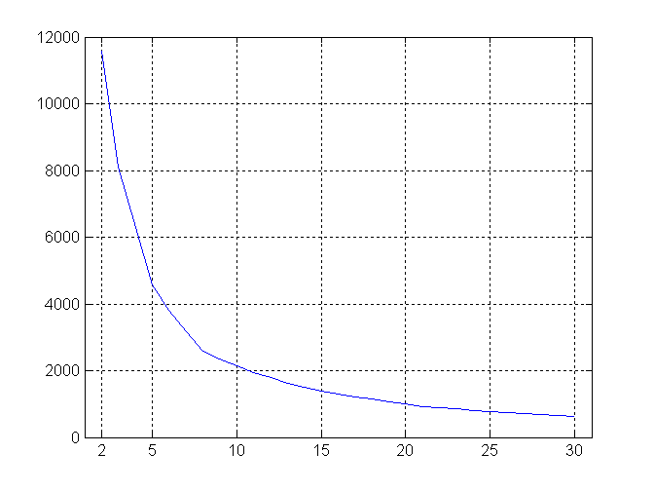
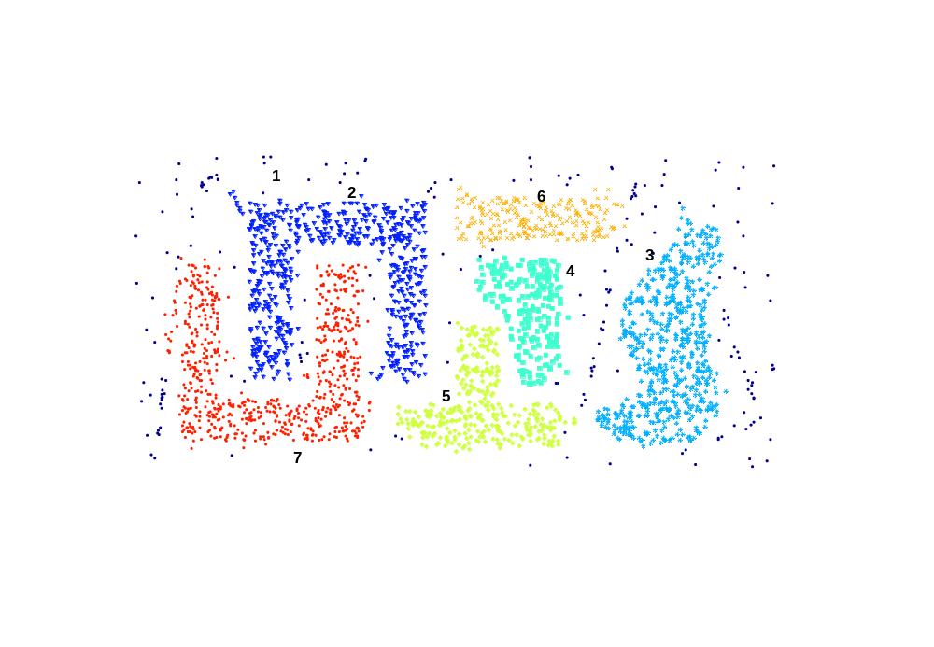
Internal Measures: SSE
SSE curve for a more complicated data set
SSE of clusters found using K-means

Slide 78
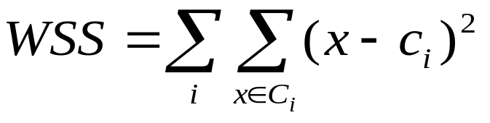
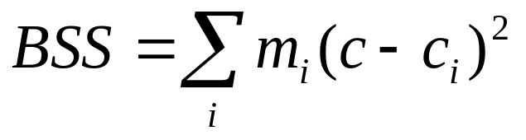
Internal Measures: Cohesion and Separation
Cluster Cohesion: Measures how closely related are objects in a cluster
Cluster Separation: Measure how distinct or well-separated a cluster is from other clusters
Example: Squared Error
  Cohesion is measured by the within cluster sum of squares (SSE)
  Separation is measured by the between cluster sum of squares
      Where m_{i} is the size of cluster i
We want this to be small
We want this to be large

Slide 79
Internal Measures: Cohesion and Separation
A proximity graph based approach can also be used for cohesion and separation.
  Cluster cohesion is the sum of the weight of all links within a cluster.
  Cluster separation is the sum of the weights between nodes in the cluster and nodes outside the cluster.
cohesion
separation

Slide 80
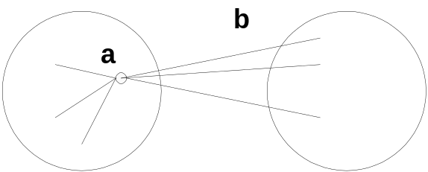
Internal Measures: Silhouette Coefficient
Silhouette Coefficient combine ideas of both cohesion and separation, but for individual points, as well as clusters and clusterings
For an individual point, i
  Calculate a = average distance of i to the points in its cluster
  Calculate b = min (average distance of i to points in another cluster)
  The silhouette coefficient for a point is then given by
  s = 1 – a/b if a < b, (or s = b/a - 1 if a ≥ b, not the usual case)
  Typically between 0 and 1.
  The closer to 1 the better.
Can calculate the Average Silhouette width for a cluster or a clustering

Slide 81
Summary
The validation of clustering structures is the most difficult and frustrating part of cluster analysis.
Clustering is has along history and still active
  There are a huge number of clustering algorithms
  More are still coming every year.
We only introduced several main algorithms. There are many others, e.g.,
  sub-space clustering, scale-up methods, neural networks based methods, fuzzy clustering, co-clustering, etc.
Clustering is hard to evaluate, but very useful in practice. This partially explains why there are still a large number of clustering algorithms being devised every year.
Clustering is highly application dependent and to some extent subjective.

Slide 82
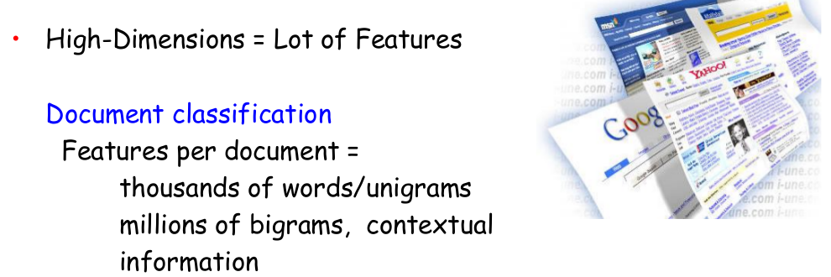
Dimensionality reduction techniques
Another unsupervised learning setting, e.g PCA (Prinicipal component analsysis)
Dimensionality reduction is simply, the process of reducing the dimension of your feature set.
Your feature set could be a dataset with a hundred columns (i.e. features).

Slide 83
Dimensionality reduction techniques
Dimensionality reduction
  Represent the data x₁ , . . . , x_{n} ∈ R^{d} in a subspace of lower dimension with as little loss of information as possible
Advantages:
  Visualiaztion
  Lower computation and time complexity
  Avoid overfiting and reduce noise

Slide 84
Dimensionality reduction techniques
Problem settings:
  Given x 1 , . . . , x n ∈ R^{d}
  find a k -dimensional subspace
  such that the data projected onto that space
  is as close to the original data as possible
  Common techniques:
    Principal Component Analysis(PCA)
    Factor Analysis
    Linear Discriminant Analysis( LDA)
    Multiple Correspondence Analysis (MCA)
    t-Distributed Stochastic Neighbour Embedding (t-SNE)
please read the details of each

Slide 85
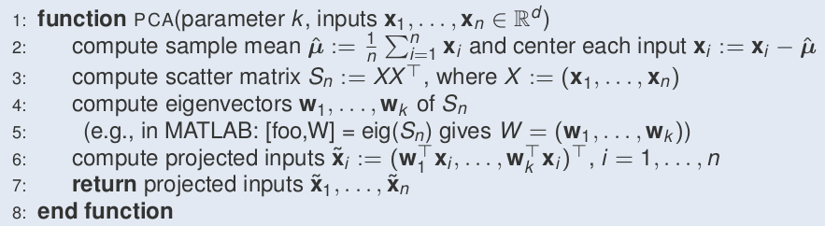
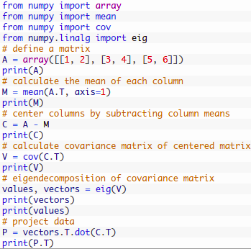
Dimensionality reduction techniques
The most common and well known dimensionality reduction (PCA, LDA, FA)
  Principal Component Analysis(PCA): PCA rotates and projects data along the direction of increasing variance. The features with the maximum variance are the principal components.
(e.g eigenvalue, eigenvector= eig(Sn) gives w=w₁,...w_{k})

Slide 86
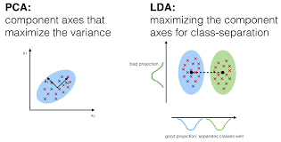
Dimensionality reduction techniques
Linear Discriminant Analysis( LDA): projects data in a way that the class separability is maximised. Examples from same class are put closely together by the projection. Examples from different classes are placed far apart by the projection
Please read the details (maths and practicl implmentation) from the following link
https://medium.com/machine-learning-researcher/dimensionality-reduction-pca-and-lda-6be91734f567
https://jakevdp.github.io/PythonDataScienceHandbook/05.09-principal-component-analysis.html

Slide 87
Dimensionality reduction techniques
Factor Analysis: a technique that is used to reduce a large number of variables into fewer numbers of factors.
  The values of observed data are expressed as functions of a number of possible causes in order to find which are the most important.
  The observations are assumed to be caused by a linear transformation of lower dimensional latent factors and added Gaussian noise.

Slide 88
Practical examples in Python/R
Implement k-means clustering

